Slide 1
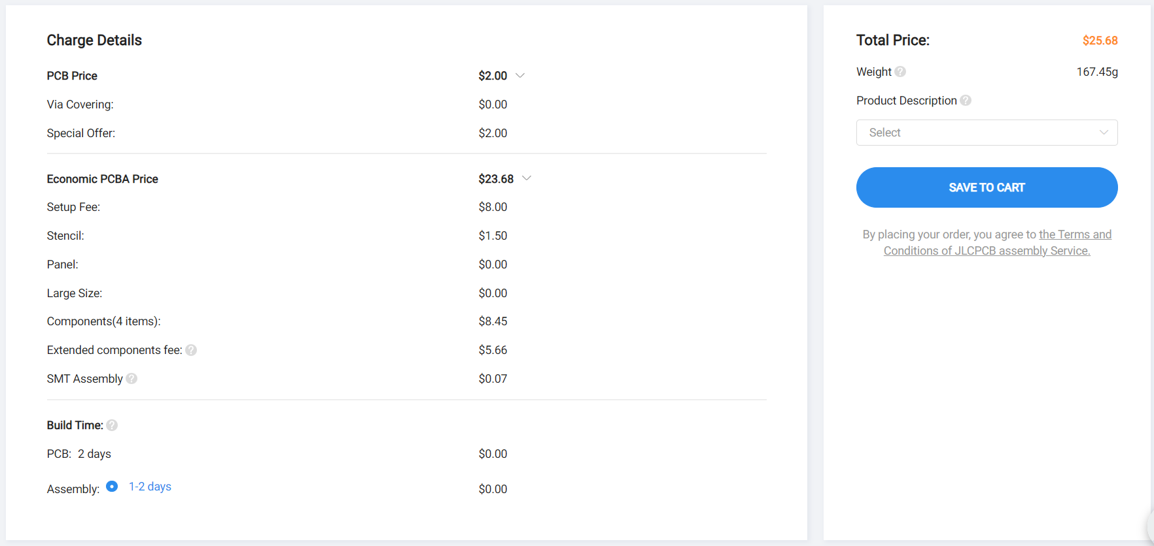
Sensor PCB cost

Slide 2
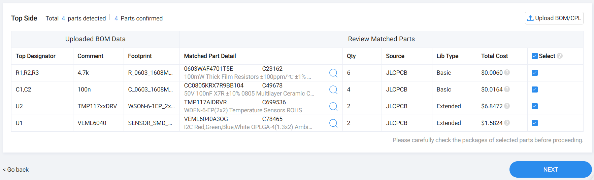
Sensor PCB BOM

Slide 3

RGB LED PCB cost

Slide 4
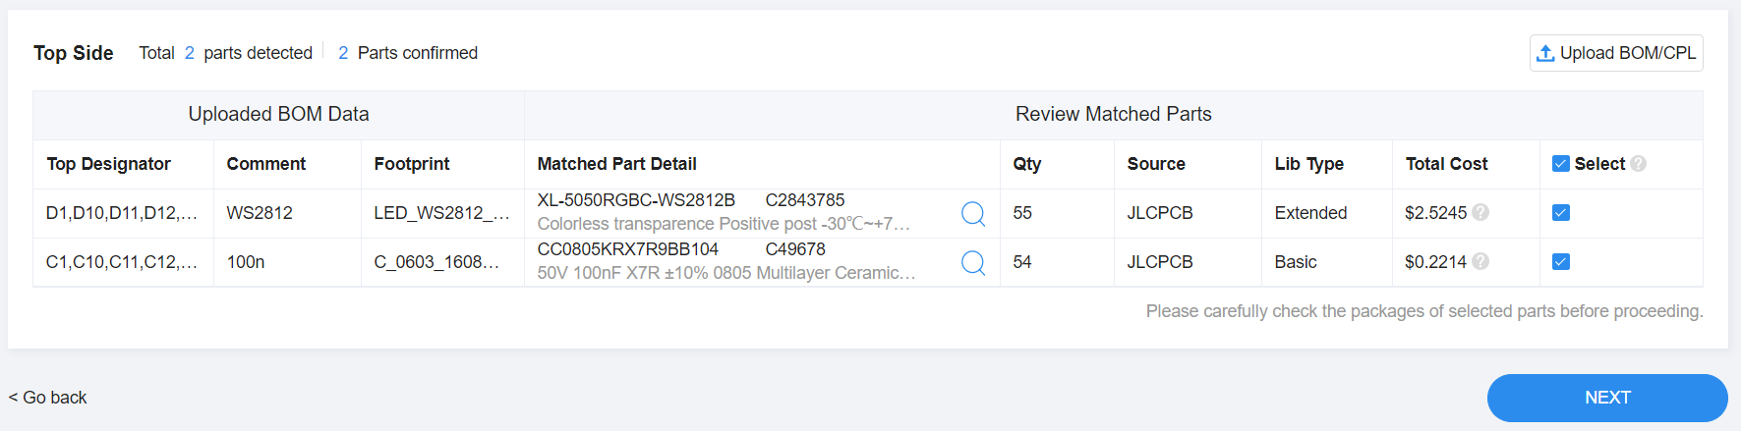
RGB LED PCB BOM

